Slide 1
Sickness and Going to the Doctor

Slide 2
Flu Fever

Slide 3
Headache Stomach ache

Slide 4
Back pain Toothache

Slide 5
Cold Cough

Slide 6
Sore throat Vomiting

Slide 7
Rash Dizziness/Nausea

Slide 14
To have/ To feel
We can describe some illness with the verb TO HAVE and others with the verb TO FEEL. Complete the exercises below.
To have | To feel
Back pain, a fever, a cough, sick, ill, a headache, bad, a sore throat, dizzy, nauseous, flu, cold, a rash, toothache, awful

Slide 15
Symptoms
Some illnesses share the same symptoms. Match the illness with the symptoms. More than one per illness is possible.
Illness
Flu
Nausea
Fever
Cold
Symptom
High Temperature
Coughing
Sneezing
Sweating
Vomiting
Blocked/ Runny Nose
Headache

Slide 16
Advice ‘Should’ + ‘Shouldn’t’
You can give advice about someone’s illness by using ‘should’ and ‘shouldn’t.
You should take some medicine!

Slide 17
Advice ‘Should’ + ‘Shouldn’t’
Match the illness with the advice
You shouldn’t eat chocolate
You should take some paracetamol
You should go to the dentist
You should put some cream on it
You should stay in bed
You shouldn’t go to school
You should go to the doctor’s
Flu
Toothache
Rash
Headache
Stomach ache

Slide 18
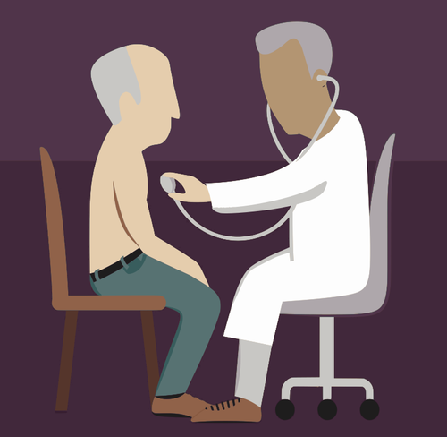
Roleplay - Doctor’s office
Create a roleplay situation in a doctor’s office to perform for the class. You MUST use the vocabulary from this lesson.
Patient: Describe how you FEEL and your SYMPTOMS
Doctor: Ask about the patient’s SYMPTOMS, and give them appropriate ADVICE

